Slide 1
System modeling
Embedded systems - 2023/24
Aurore (aurore.isep@gmail.com) & Hugo (myrobotswillconquertheworld@gmail.com)

Slide 2
What is this course about?
Why am I here? What is the purpose of my life?
Experience and learn how to design, create, and implement a small embedded robotic solution (with Lego Ev3), while working as an international team.
We (your teachers) will be your clients, and we will submit to your teams problems that needs to be solved.
We expect you to behave as professional engineers
No question is stupid > ask by mail, 24/7

Slide 3
Schedule
When will you have the joy of seeing us?
Lessons are on monday afternoon, on the following days :
November 20th and 27th
December 4th, 11th and 18th
January 8th, 15th (Final exam)
We expect you to work more than just those few hours together
We will review each group progress at each lesson
Please tell us (by mail) if you are absent beforehand

Slide 4
Team organisation
Who will be my best friends for the 5 coming months?
Team of 5 students, mixed (French and international, girls and boys, work-study and normal students, etc.)
Each team member will have a specific job (project manager, software chief,…)
This is to avoid procrastination of some team members
You have to create your groups today

Slide 5
Subjects : problems to be solved
What you are really going to do
2 different subjects :
Search and rescue
Anti drone system
Each subject has a short specification, with 3 levels : bronze, silver, gold.
We will also give you a detailed test specification for each level

Slide 6
Subjects
What you are really going to do
Once you have created a team and picked a subject, you will have to achieve every level (bronze to gold) of your subject.
WARNING : this year, you have LESS time than the previous years
Your first task will be to tell us how you intend to solve this problem (in a theoretical way).
And to learn the basics of Lego / Ev3dev.
Every level (bronze, …) will be tested by the teachers and graded

Slide 7
Grading
Where are the points? How am I getting paid?
General concept :
50% of the points on 4 different achievements (bronze, silver, gold, personal and group impression) (10 points)
50% of the points on the final presentation (10 points)

Slide 8
Achievement 0
Due NLT tonight
Form a mixed group, find a name for the group
Choose a subject, read the specs
Discuss it with your clients / teacher
Learn the basics of Lego Mindstorm and EV3
Appoint group members to all position
Open a github project to host your code
Report all of this by mail

Slide 9
Achievement « Basic » (2.5pts)
Due NLT nov 27th 2023
Setup all your dev environment (EV3dev setup)
Test a simple sensor - motor loop and demonstrate to your teacher
Present (with a ppt) a first design solution and the first 3 steps of your robot, including a description of relevant tests
(Optionnal) Give us a list of parts to buy
Report by mail to your teachers

Slide 10
Achievement « bronze », « silver », etc.
… see 2023_System_modelling.pdf and your test specification sheet

Slide 11
Achievement « team work and personal skills »
Easiest points to get… or not.
Personal skills and investment in the group (Quality of your work, attitude, professionalism, etc.)
General team impression, including but not limited to:
team work,
timing,
professionalism
writing skills,
etc.
Good usage of any needed tools (Github, EV3, Python, Clarity of source code)
Quality of the documentation
Beauty and style of your robot

Slide 12
Final presentation « gold » (10 points)
On January 15th
On the last day, you will demonstrate the gold level of your robot, and present a PPT to your teachers (30 min), including :
Code structure
Hardware description
Specifications and tests reviews
Problem encountered
Any other relevant information
Do a live demonstration (15min)
Answer questions (15min)

Slide 13
Lego Mindstorm
Short tutorial

Slide 14
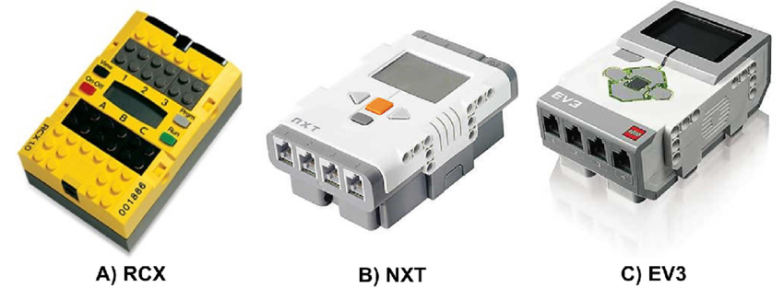
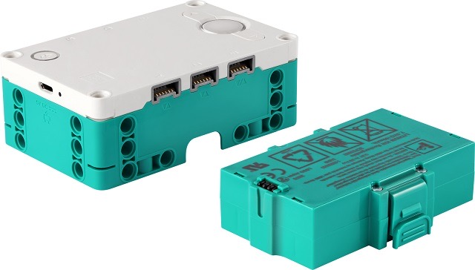
What is Lego Mindstorm ev3
> A smart brick with 4 sensors and 4 motors
Native Bluetooth,
Added wifi with a dongle
Bootable on a SD card
4 sensors, 4 motors
Some color leds
A small B&W screen
3rd generation (/!\ Red !!)
D) Inventor

Slide 15
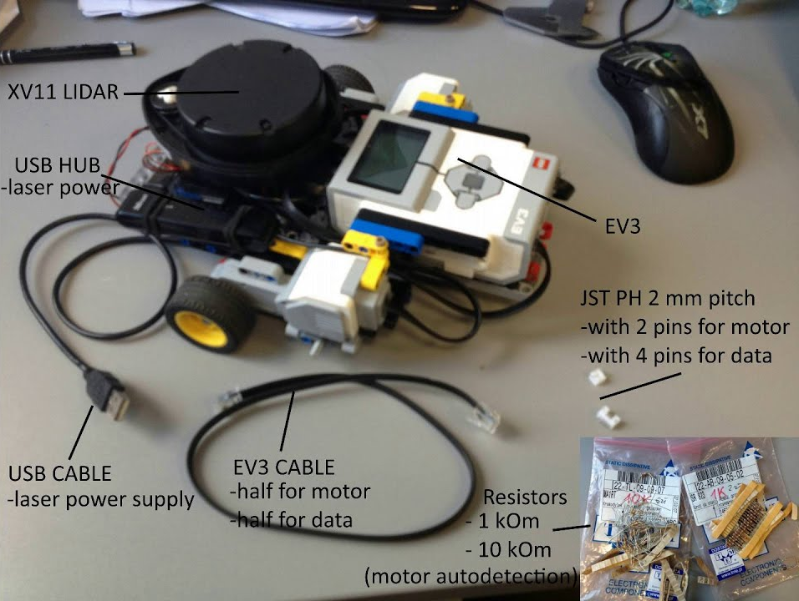
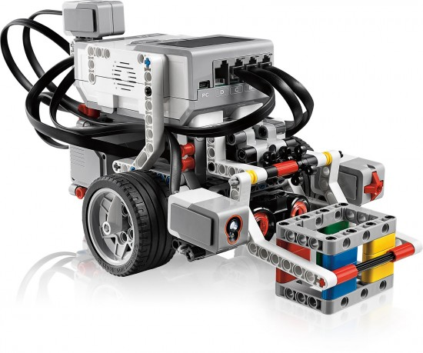
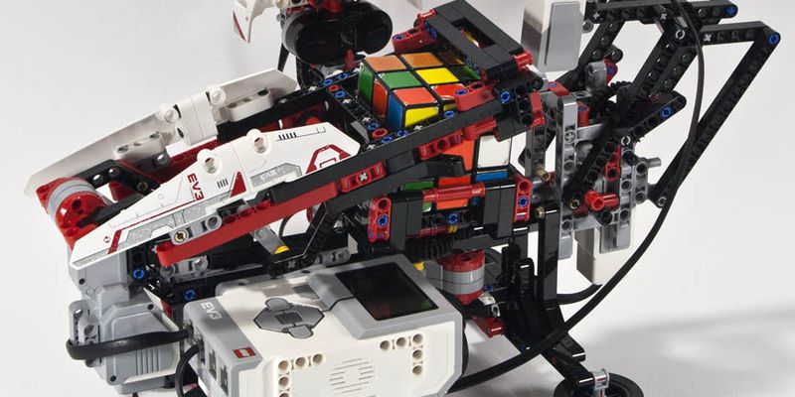
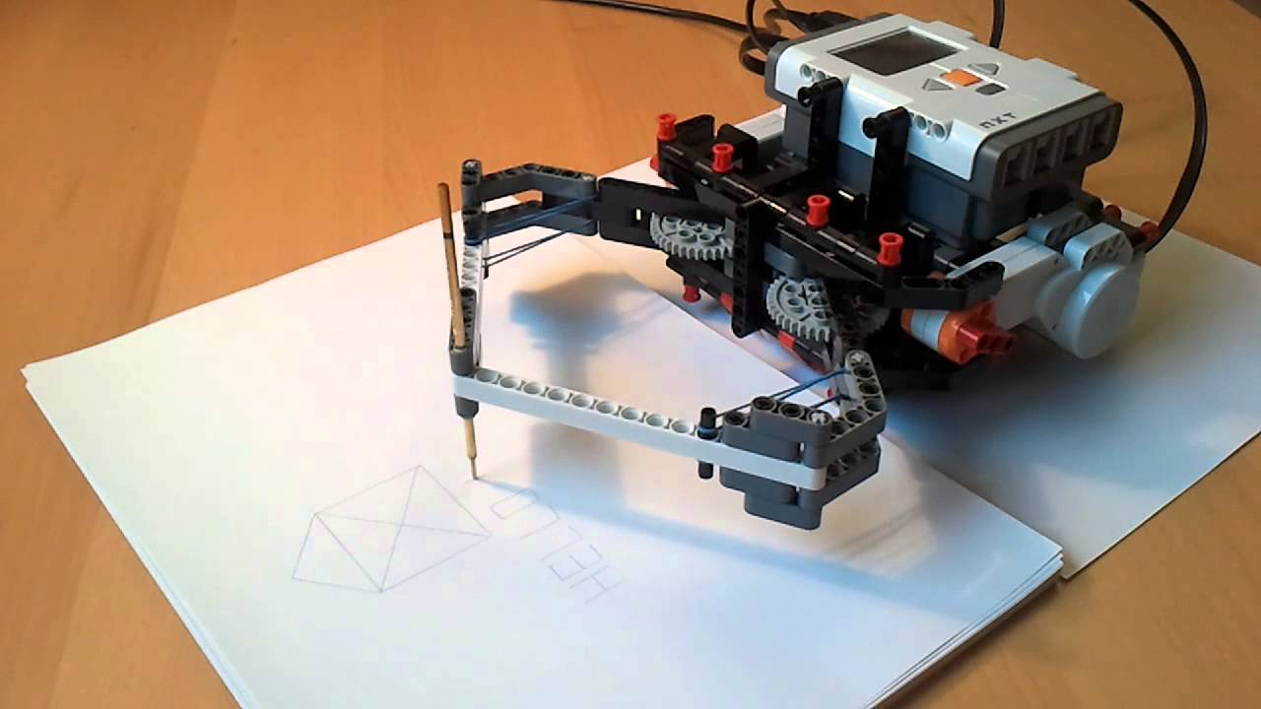
For example…

Slide 16
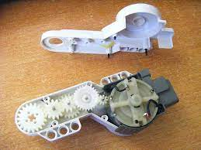
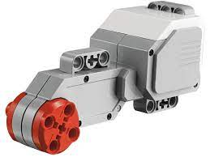
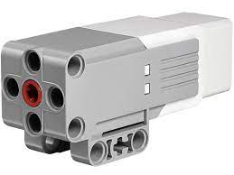
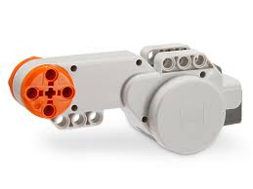
Motors
Big and small. Use red motors.
Step by step and position

Slide 17
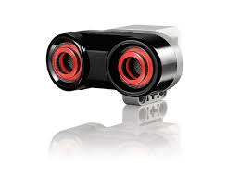
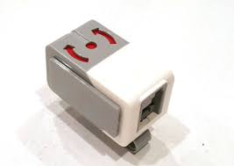
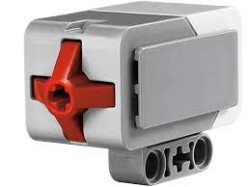
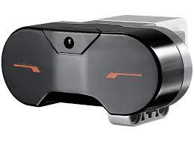
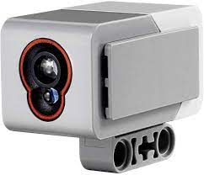
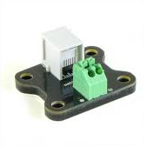
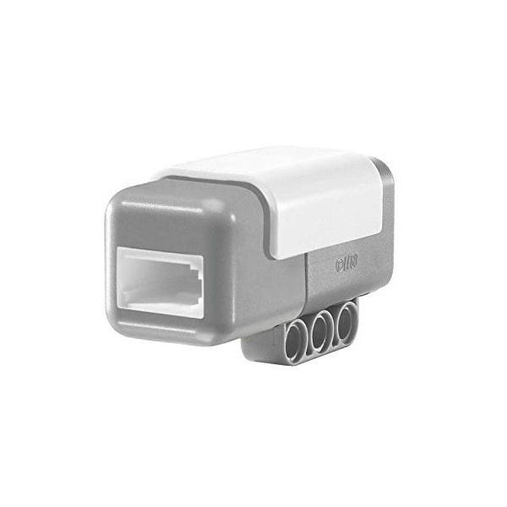
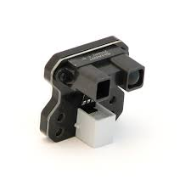
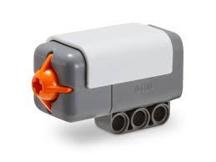
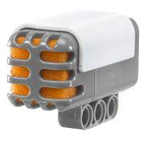
Sensors
Lego Ev3 (red) : Touch, ultrasonic, infrared, color, accelerometer
Lego Nxt (Orange): same, + sound
Third party : anything. Current, pressure, vernier, …

Slide 18
EV3dev and Python library
How to setup Linux on your brick and start working
Download EV3dev OS (https://www.ev3dev.org/docs/getting-started/). Follow tutorial.
Load it on a SD card. Make the card bootable.
Insert card in brick, boot. Boom! You have Linux.
Then establish a link between brick and your computer : https://www.ev3dev.org/docs/networking/ (BT, Wifi with SSH, USB, SD card),
Setup a Python environment (Pycharm?) on your computer,
Use ev3 python library : https://sites.google.com/site/ev3devpython/
Read and understand code examples : https://github.com/ev3dev/ev3dev-lang-python-demo
Start coding. Push code to robot. Test code. Fail, repeat, success!
Look up past years examples : https://github.com/myrobotswillconquertheworld
Dont forget to put code on your github!

Slide 19
Questions?
Let’s roll.

